Slide 1
IPL MATCH WINNER PREDICTION
USING MACHINE LEARNING
NAME : P.TAMIL CEELAN DATE: 28-01-2026
COURSE: DATA ANALYTICS & DATA SCIENCE BATCH: AUGUST-2025

Slide 2
INTRODUCTION
The primary objective of the IPL Match Winner Prediction project is to develop a reliable machine learning model capable of forecasting the winner of the IPL match. This objective is achieved through the analysis of a historical dataset spanning from 2008 to 2019, comprising 756 match records.
The model focuses on predicting match outcomes using information available prior to or at the start of the game, including the competing teams, toss winner, and toss decision.Additionally, the project aims to implement, evaluate, and compare multiple supervised machine learning algorithms.

Slide 3
PROJECT OBJECTIVE
Analyze historical IPL match data for insights.
Training multiple machine learning models.
Comparing model performance to identifying best performing model.

Slide 4
DATASET OVERVIEW
The IPL dataset contains matches played from 2008 to 2019.
The dataset has 18 columns and 756 rows.
Each row represents one match.
Key Features:
Team1 & Team2 : Competing Teams
Toss Winner : Team that won toss
Toss Decision : Batting or Fielding
Venue : Name of Stadium
Winner : Match winner

Slide 5
DATA CLEANING
Data cleaning is a crucial phase in any machine learning project, as the performance and reliability of a model largely depend on the quality of the input data.
STEPS IN DATA CLEANING
HANDLING MISSING VALUES
STANDARDIZING TEAM NAMES
REMOVING IRRELEVANT COLUMNS

Slide 6
EXPLORATORY DATA ANALYSIS (EDA)
Exploratory Data Analysis (EDA) was performed to understand the underlying structure and patterns within the dataset by examining relationships between key variables such as teams, venues, toss decisions etc.
EDA Insights:
Teams like CSK and MI consistently had higher wins.
Toss winning gives marginal edge but does not guarantee victory.
Some teams performed significantly better at their home ground.

Slide 7
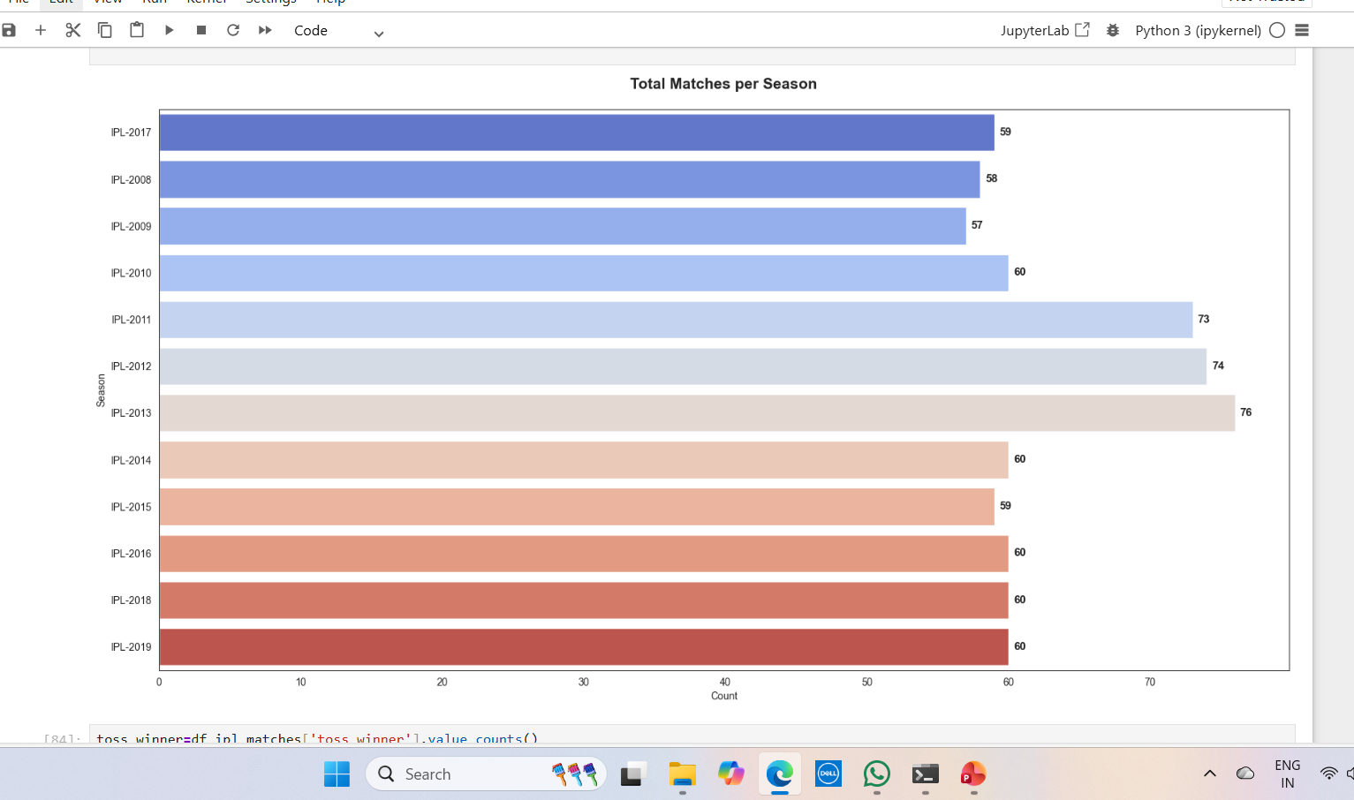
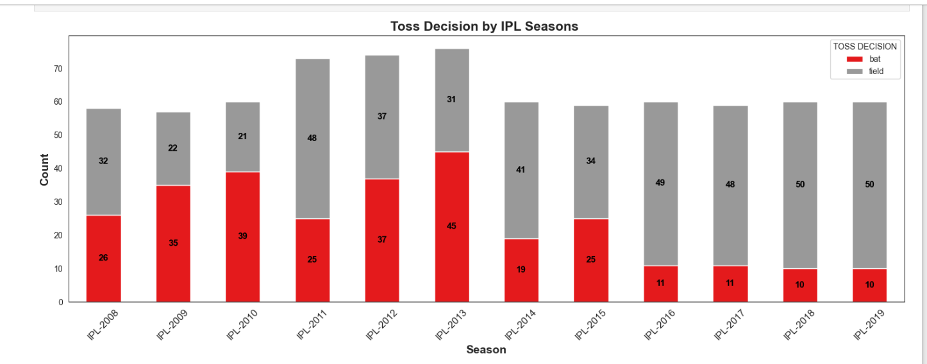
EXPLORATORY DATA ANALYSIS (EDA) VISUALS

Slide 8
MACHINE LEARNING MODEL
Supervised Learning:
Supervised Learning is a machine learning approach where models are trained on labeled data to learn the relationship between input features and known outputs, enabling accurate predictions on new data.
Supervised Machine Learning Models Used:
Logistic Regression
Support Vector Machine (SVM)
K-Nearest Neighbours (KNN)
Decision Trees
Random Forest
XGBoost

Slide 9
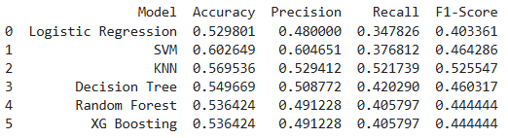
EVALUATION METRICS
Model Evaluation is the process of assessing the trained machine learning model’s performance
using appropriate metrics to determine its accuracy and ability to generalize to unseen data.
Evaluation Metrics Used:
Accuracy
Precision
Recall
F1-Score

Slide 10
MODEL COMPARISION
Multiple machine learning models were trained and evaluated using the same dataset. Among all the models SVM had higher accuracy and was selected as the best Model for IPL dataset.

Slide 11
INSIGHTS
Cities like Mumbai and Kolkata show high match frequencies.
Teams who win toss most likely wins the matches.
CSK and MI has the highest wins.
Teams Choosing fielding first tend to score their targets easily.

Slide 12
CONCLUSION
This project successfully demonstrates the effectiveness of machine learning techniques for predicting IPL match outcomes. Comprehensive data cleaning, in-depth exploratory data analysis, and careful feature engineering ensured the creation of a high-quality and reliable dataset. After evaluating multiple machine learning models, the Support Vector Machine (SVM) achieved the highest accuracy following hyperparameter tuning, highlighting its suitability and effectiveness for the prediction.

Slide 13
THANK YOU

